Slide 1

Cyclistic Bikeshare
by Tymon Nechipurenko

Slide 2
Scenario:
Cyclistic is a bike sharing company located in Chicago.
Their current business structure is based on single ride, full day and annual memberships.
The Director of Marketing is seeking to convert casual riders (single and full day) to annual members, as they're more profitable.
Marketing needs a better understanding about their riders in order inform their upcoming digital marketing campaign to expand Cyclistic’s membership rate.

Slide 3
Objectives:
How do annual members and casual riders use Cyclistic bikes differently?
Why would casual riders buy Cyclistic annual memberships?
How can Cyclistic use digital media to influence casual riders to become members?

Slide 4
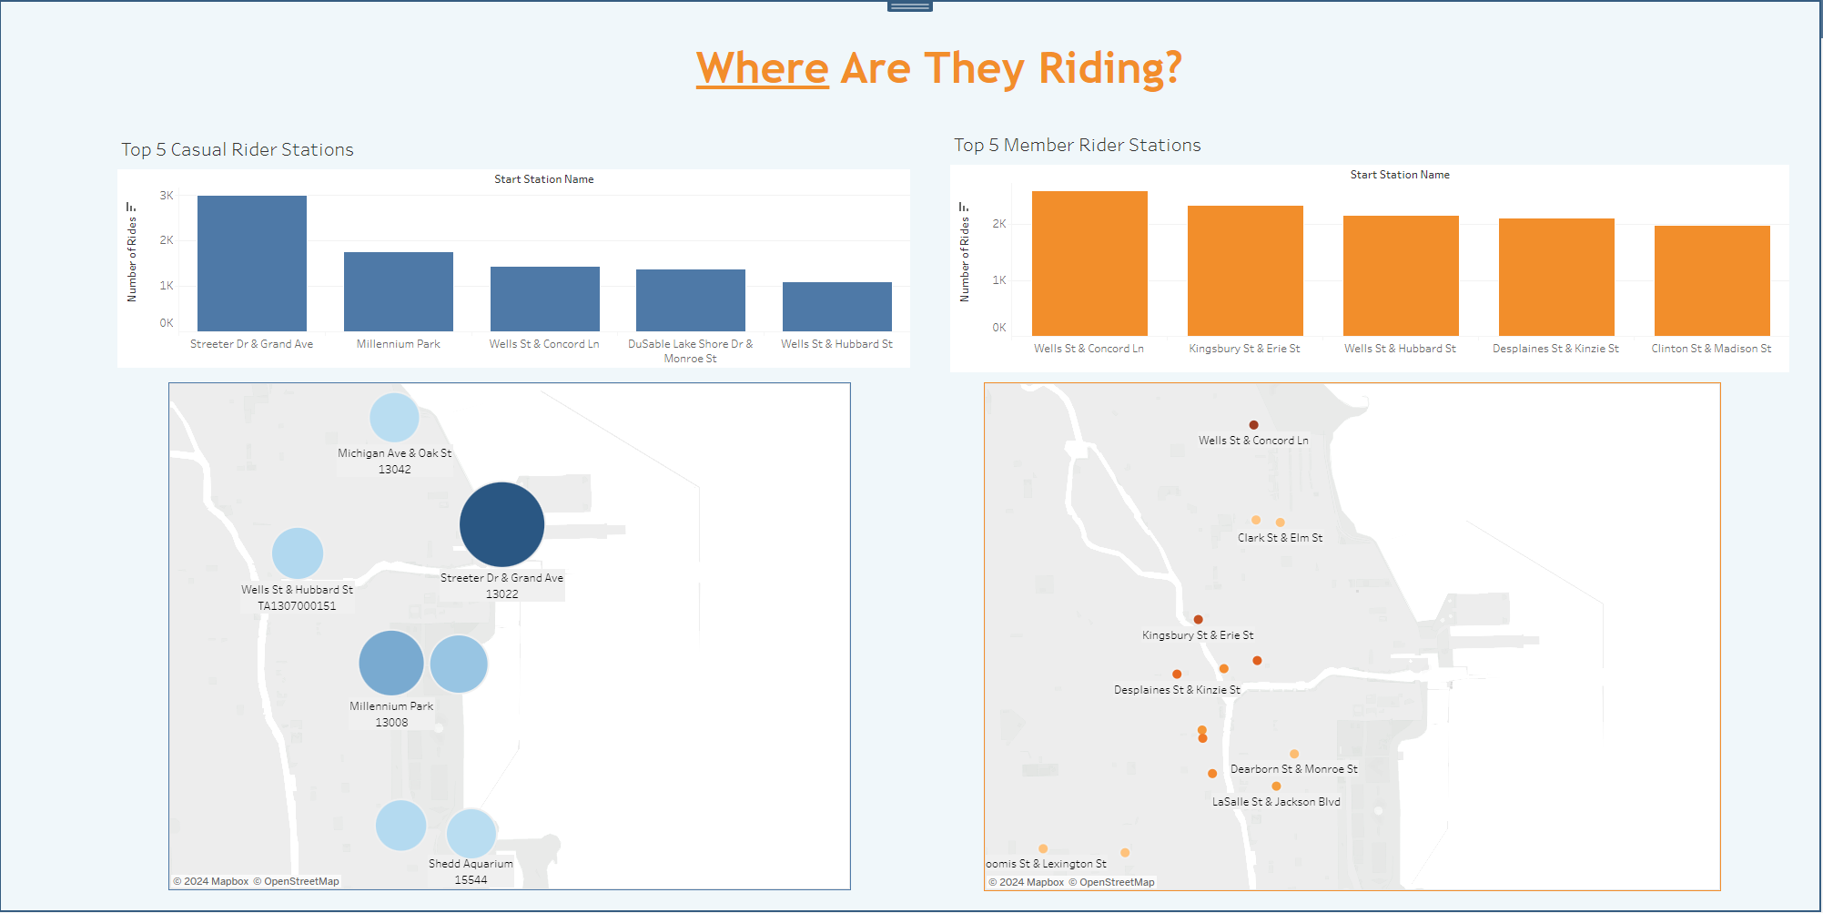
Casual Riders: Coastline along the waterfront, likely for recreational purposes. Member Riders: Inner city urban commute, more functional purpose.

Slide 5
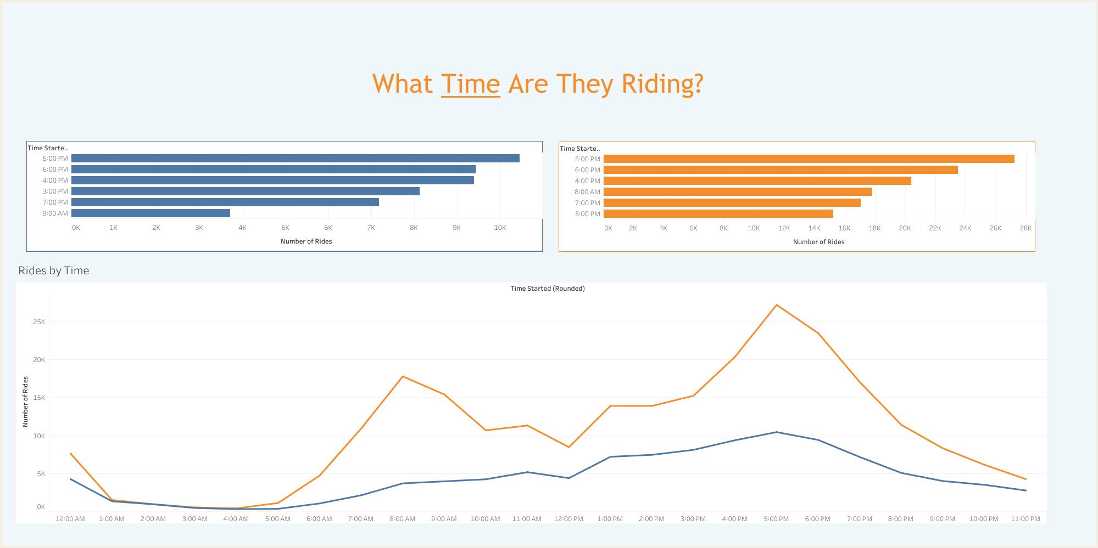
Both start riding after working hours. Member riders more likely to use bikes for morning commute.

Slide 6
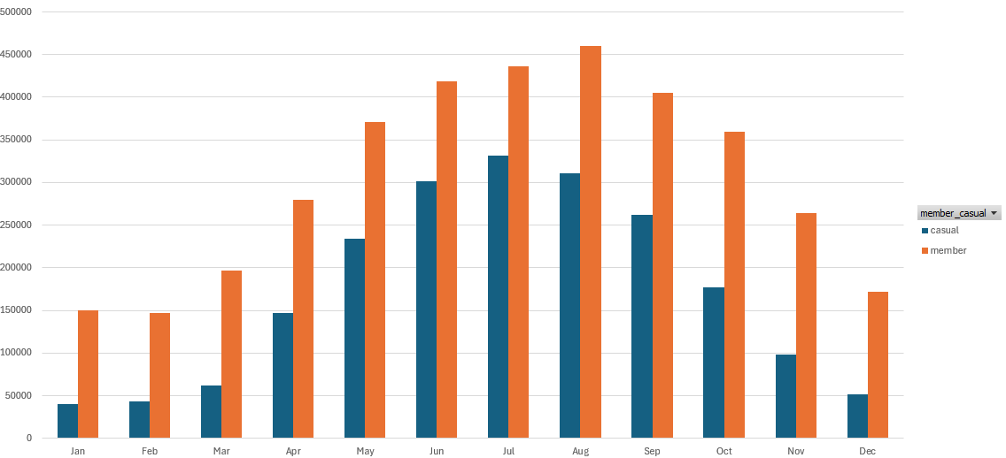
Both demographics increase biking during warmer months. Both demographics bike year-round.
What Months Are They Riding?

Slide 7
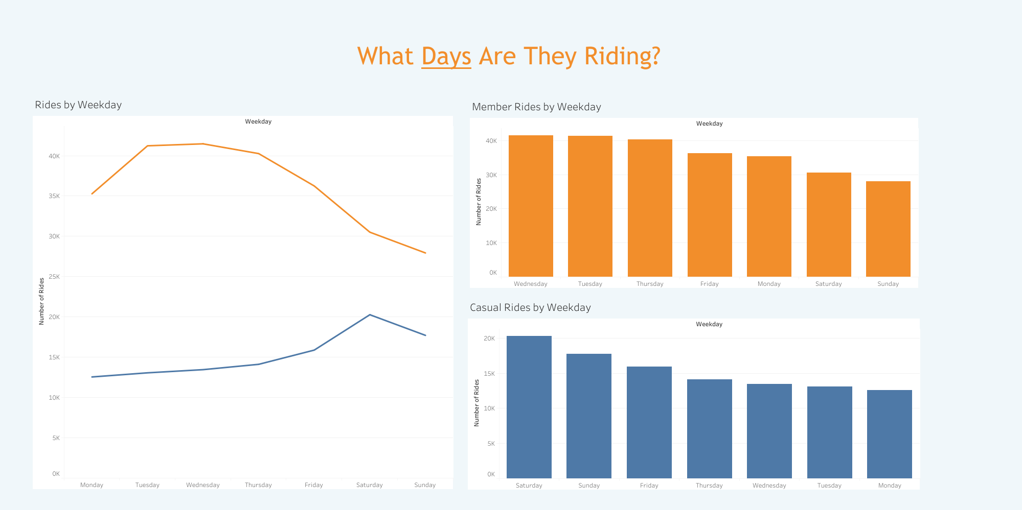
Casual Riders prefer weekends. Member Riders prefer weekdays.

Slide 8
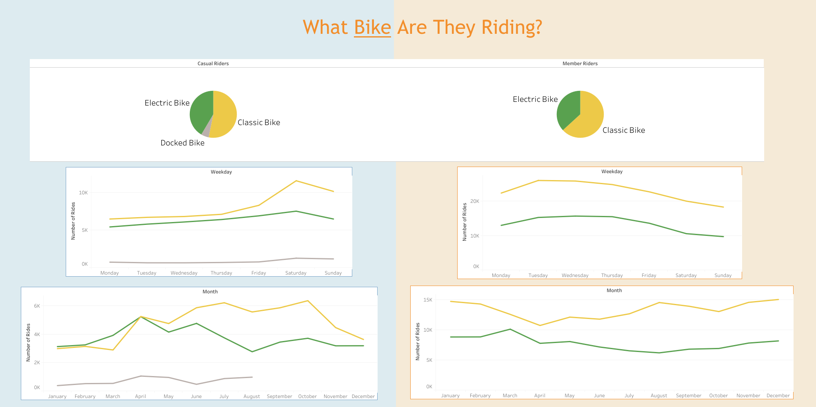
Classic bike preferred by both rider types. Causal riders have more variety in bike choice first half of the year, especially e-bikes.

Slide 9
How do casual riders and members compare?
Casual Riders:
-Bike less year round
-Start rides at stations along the waterfront
-Prefer weekends
-More variety in bike choice first half of the year
Member Riders:
-Bike more year round
-Inner city urban commuters
-Prefer weekdays
-More likely to use bikes for morning commute
Both:
-Primarily start riding after working hours.
-Prefer classic bikes the most
-Start riding more same time of year
-Bike year-round

Slide 10
Why would casual riders buy annual memberships?
Casual Riders, though at lower rates, bike year-round and could benefit from annual rates.
Casual Riders appear to use bikesharing more recreationally on weekends. Memberships offer more convenience for spontaneous weekend trips along the beach.
Casual riders, like members, most often ride around 5-6pm after working hours. Memberships allow more efficient ease of access to bikes after long day’s work, integrating bikesharing into their daily activities.

Slide 11
How can Cyclistic use digital media to influence casual riders into buying memberships?
Target advertisements toward users at coastal starting stations.
User increase highly correlated with temperature and the seasons. For maximum reach, marketing campaigns should occur in Spring and Summer.
Casual riders notably have higher rates of using e-bikes during the Spring. Incorporate e-bikes specifically in Spring marketing campaigns.
Casual riders are recreational users, so emphasize the convenience of not having to pay microtransactions to access bikes during their relaxation time.
Offer discounts and present benefits of annual memberships on weekends when casual riders are most likely to use Cyclistic’s services.

Slide 12
Further Recommendations:
Need more data on consumers such as user’s gender, age, demographic and address to get a better understand of who’s using Cyclistic as to inform marketing strategy.
Further insight into pricing models as to offer a more comprehensive understanding regarding the benefits of memberships over single use/full day passes
More granularity in what makes up the casual rider category. Segmenting between single use and full day pass users would allow more accuracy in tracking behaviors for targeted marketing purposes.

